Slide 1
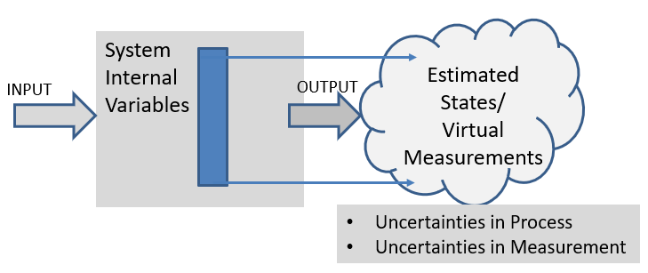
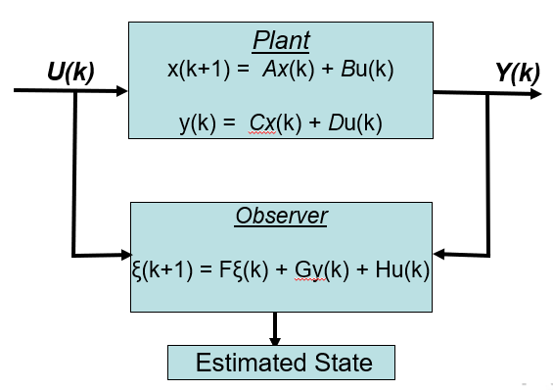
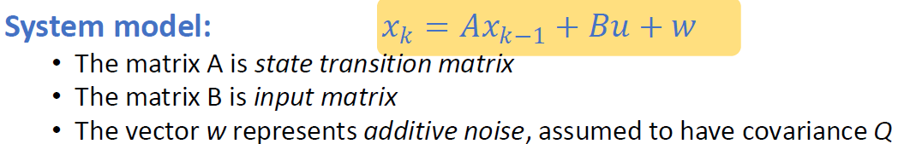
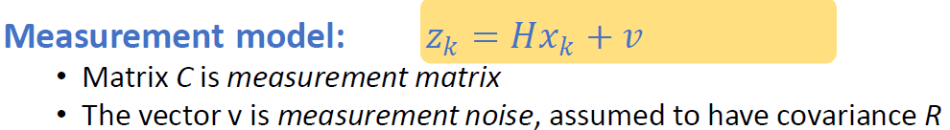
Acknowledgement Internet Images, available in Public Domain, have been used in many Slides of this Presentation. Some of the Images have also been Modified/Superimposed. Used only for Academic Purpose/Understanding.
Takeaways :
The State Estimation Problem --- Kalman Filter
Kalman Filter as a Covariance Minimization Problem
Kalman Filter in the Bayesian Framework
Lecture-10-B
Factoring in Uncertainties of Process & Measurement
Extending the Observer Concept to a Stochastic Estimator

Slide 2
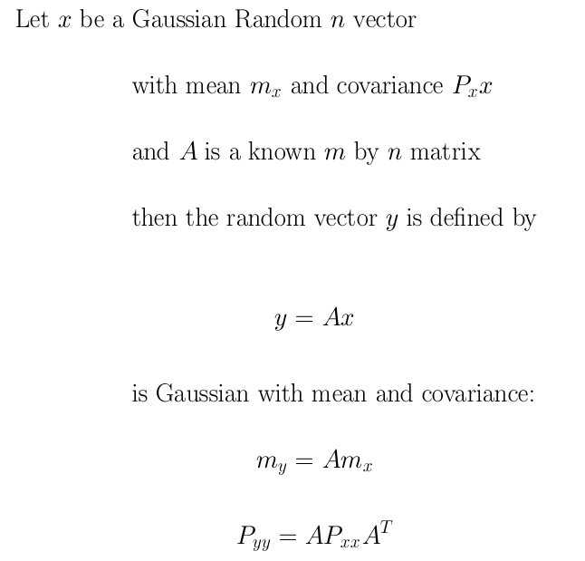
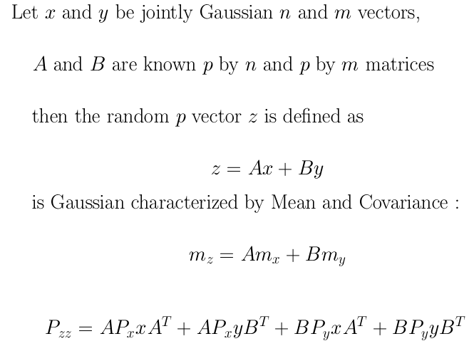
Linear Transformations on a Gaussian Random Variable
Assignment

Slide 3
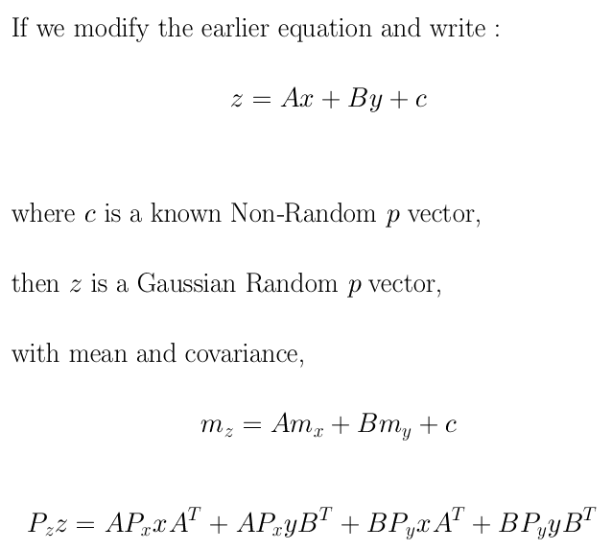
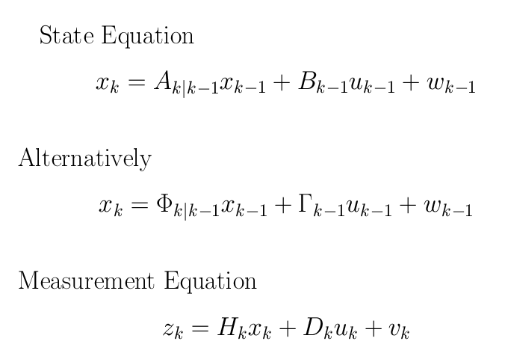

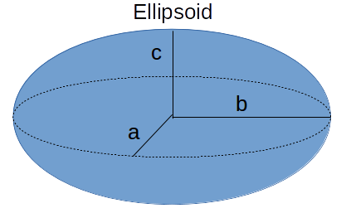
Linear Combinations of Jointly Gaussian Random Variables & Non-Random Vectors are also Gaussian Random Variables
+ Q

Slide 4
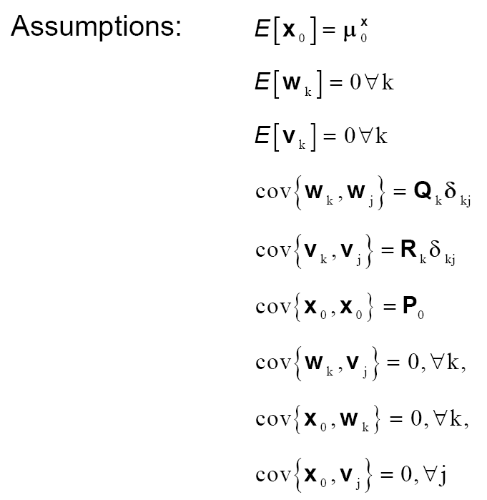
System Dynamics with Forcing Function & Noise
Assumptions

Slide 5


Understanding the Prediction & Update Process/ Steps
Update
Prediction
(k-1)+
(k)-
(k)+
k-1
k
z(k-1)
z(k)

Slide 6
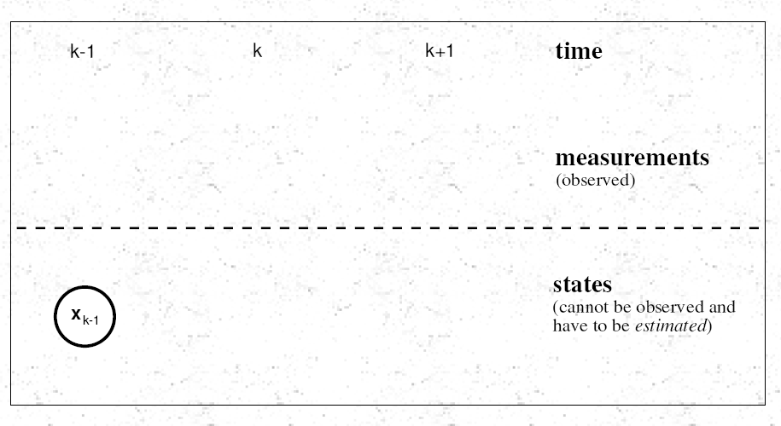
Propagating from (k-1) to (k) to (k+1)

Slide 7
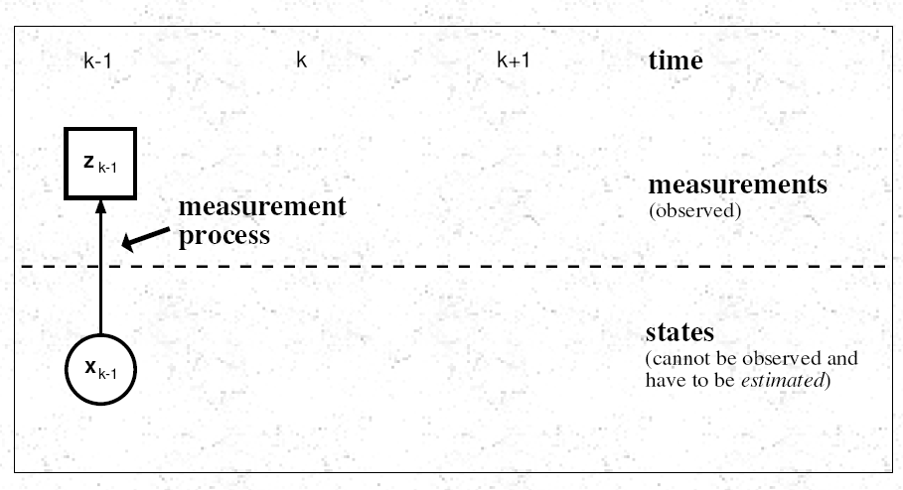

Slide 8
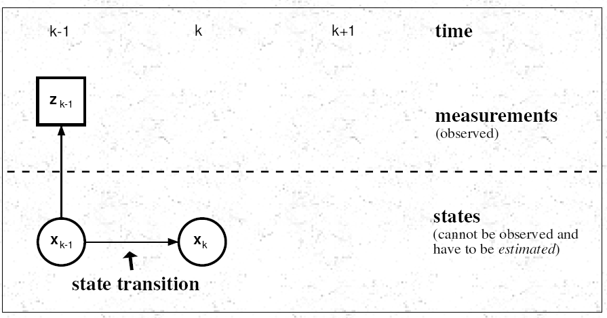

Slide 9
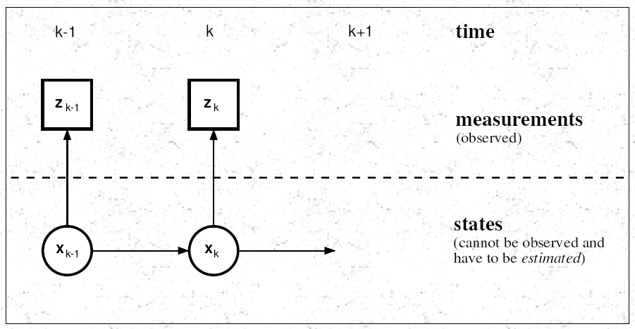

Slide 10
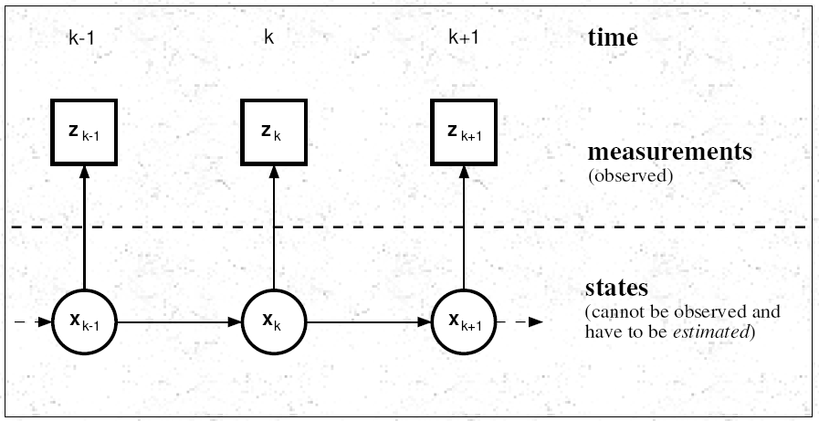

Slide 11
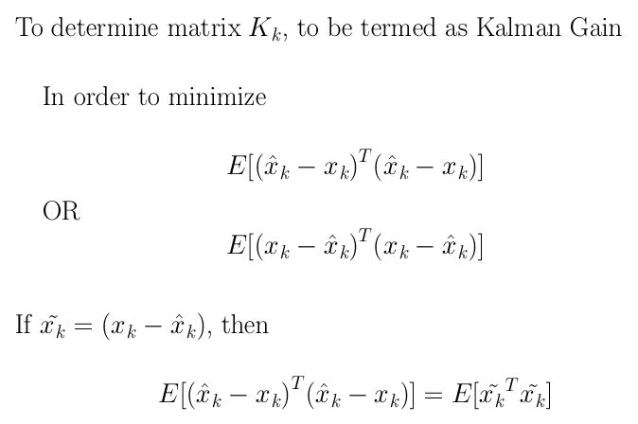
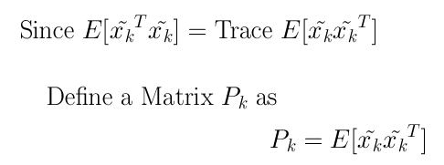
Kalman Gain & Covariance

Slide 12

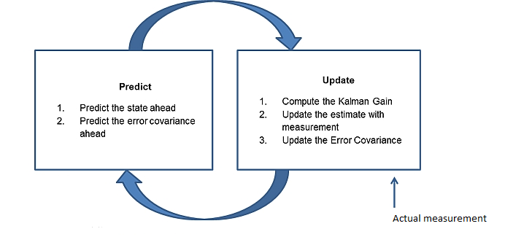
Understanding the Prediction & Update Process/ Steps
Update
Prediction
(k-1)+
(k)-
(k)+
k-1
k
z(k-1)
z(k)

Slide 13
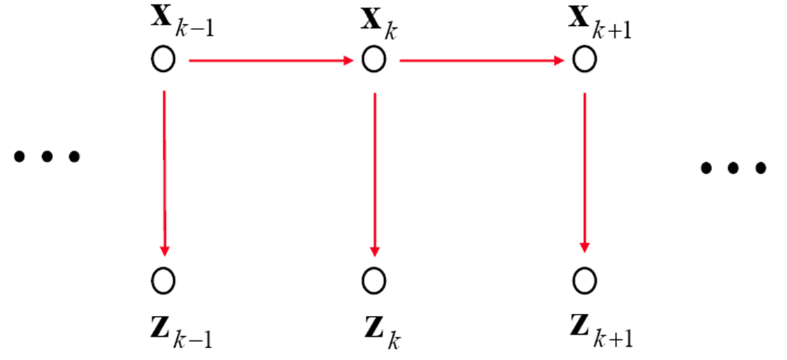
Prediction & Update

Slide 14
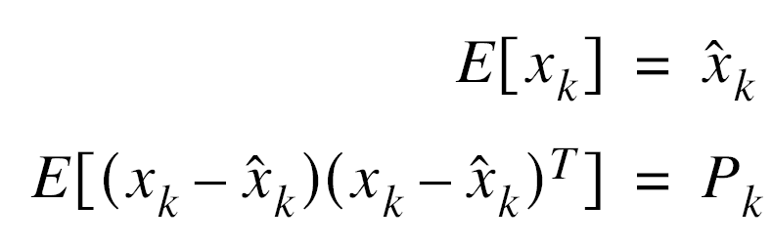
An Optimal State Estimator
Estimating the State
Minimizes the Error
Obtaining the Mean & Covariance

Slide 15




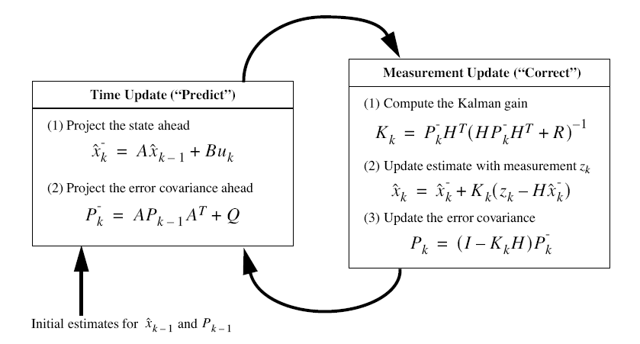
Review of the Prediction & Update Process/ Steps
Update
+ Q
(k-1)+
(k)-
(k)+
Prediction of the State
k
k-1
z(k)
z(k-1)

Slide 16

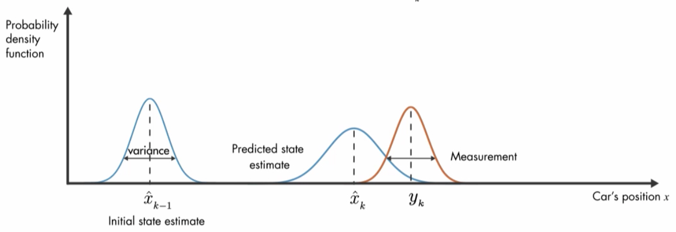
Propagation of a Conditional Density Function
Update
(k-1)+
(k)-
(k)+
Prediction
k-1
k
z(k-1)
z(k)

Slide 17
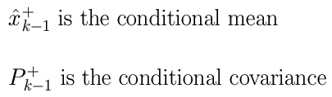

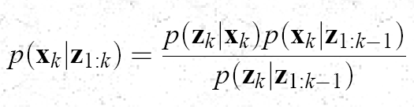
Formulating the Gaussian Density Function
Kalman Filter --- The Bayesian Approach
Establish the Independence of Noise Function
Establish Gaussianity of the Prior Function
Computing the Mean & Covariance of the Prior
Update
(k-1)+
(k)-
(k)+
Prediction
Mean & Covariance of the Likelihood
k-1
k
Show all three functions are Gaussian
z(k-1)
Likelihood Function
Prior Function
z(k)
Plug the Gaussian Expressions with Mean & Variance of each Term
Understand the “Posterior” Function
Evidence Function
Mean & Covariance of the Evidence

Slide 18

Plug the Gaussian Expressions with Mean & Variance of each Term
Substituting expressions for
PDF on the RHS
Likelihood
Prior
By plugging in the
Gaussian Expressions
of the
Prior, Likelihood & Evidence
Terms, on the RHS,
we Obtain
Evidence
PDF for Posterior

Slide 19




Slide 20
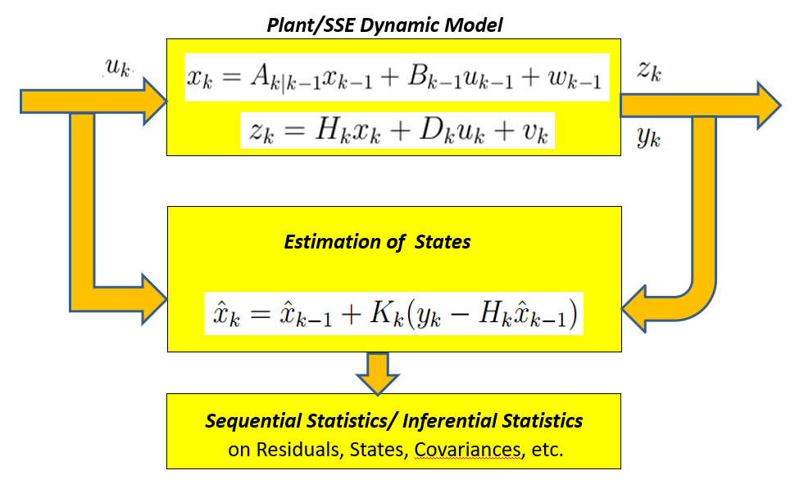
The Estimation Strategy

Slide 21
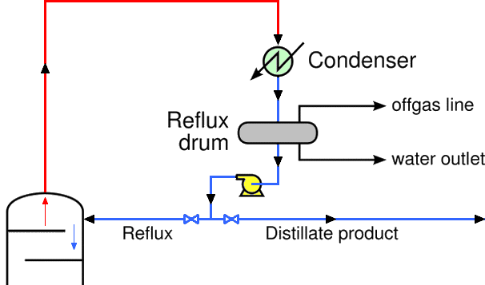
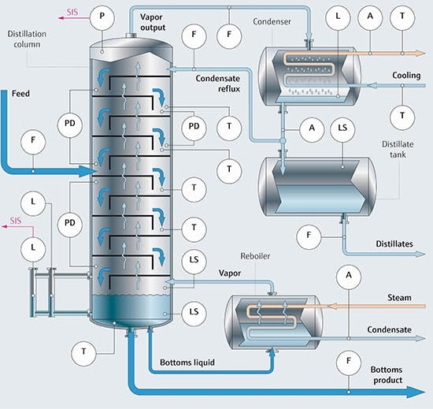
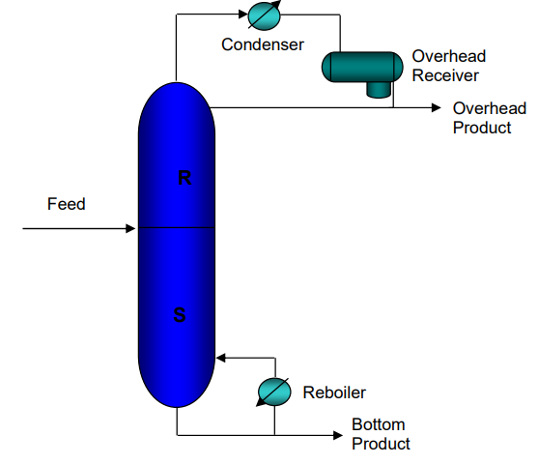
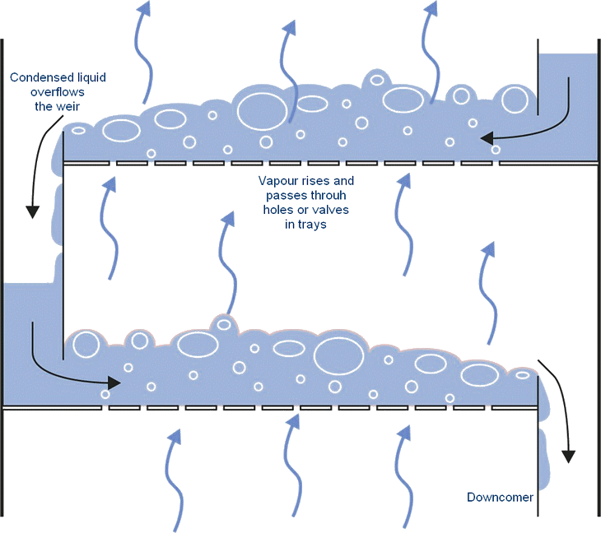
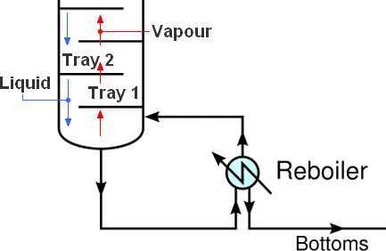
Applications

Slide 22
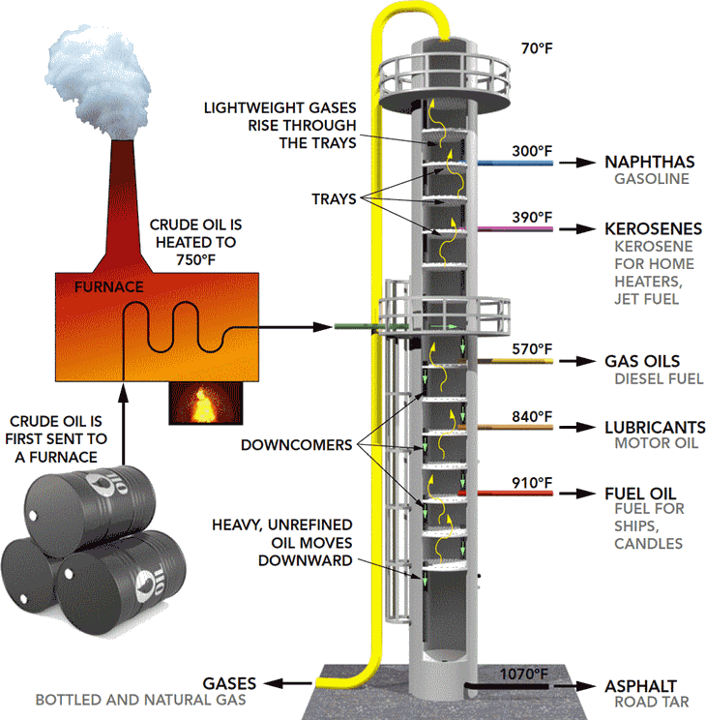
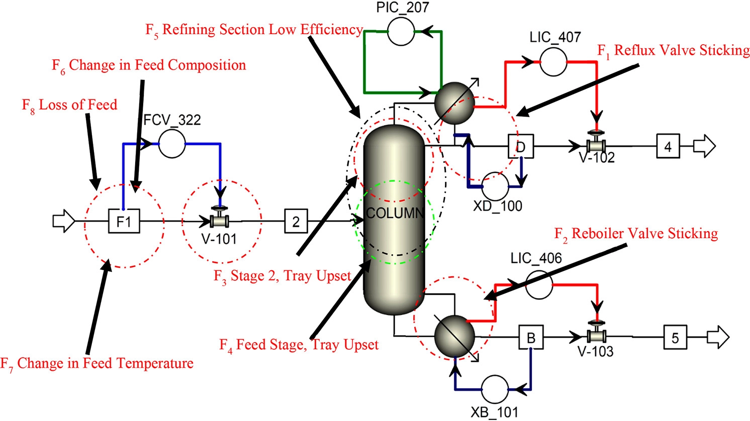
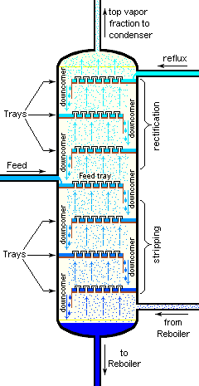
Estimation and Performance Monitoring Strategies
Model Based Strategies
First Principle/ Domain/Physics based
Data Oriented
Feature Vectors
Statistical Approaches

Slide 23
Assignment -1 ---- To Derive all the Expressions, for Covariance Minimization

Slide 24
The Kalman Filter

Slide 25
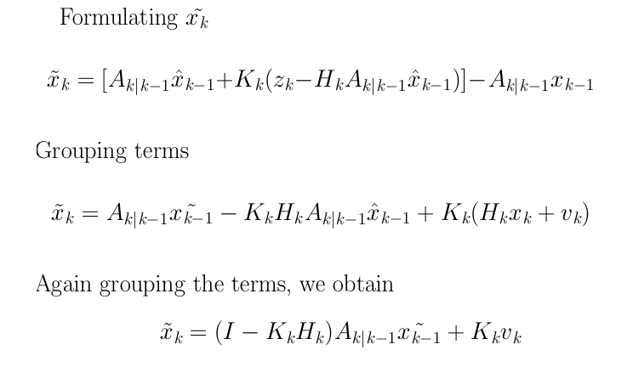
To Obtain the Expression for Covariance
Step 1 :

Slide 26



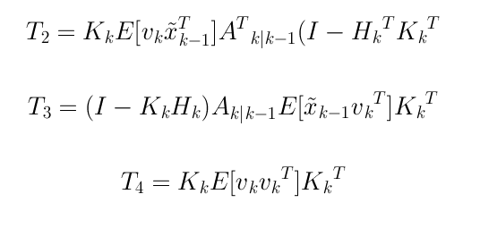
Obtaining the Covariance Matrix
Step 2 : Expanding the term

Slide 27
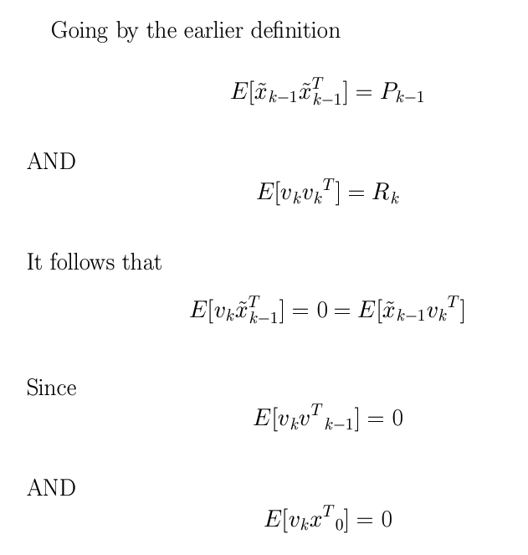

Slide 28
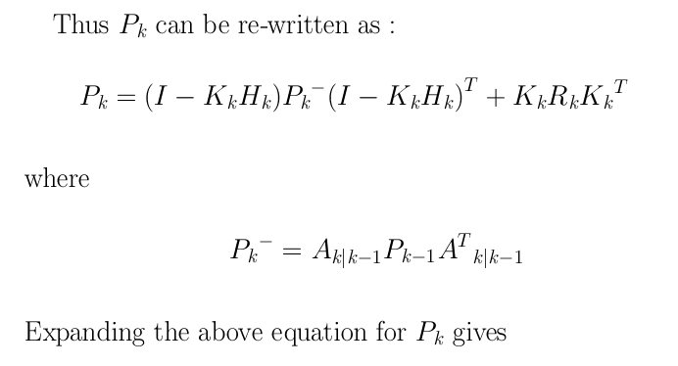
Obtaining Apriori P

Slide 29




Obtaining K

Slide 30
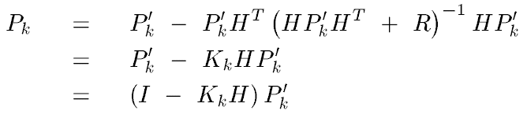
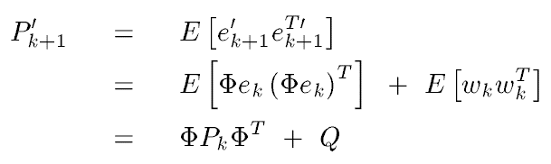
Obtaining the P Matrix

Slide 32
The Kalman Filter

